Slide 1
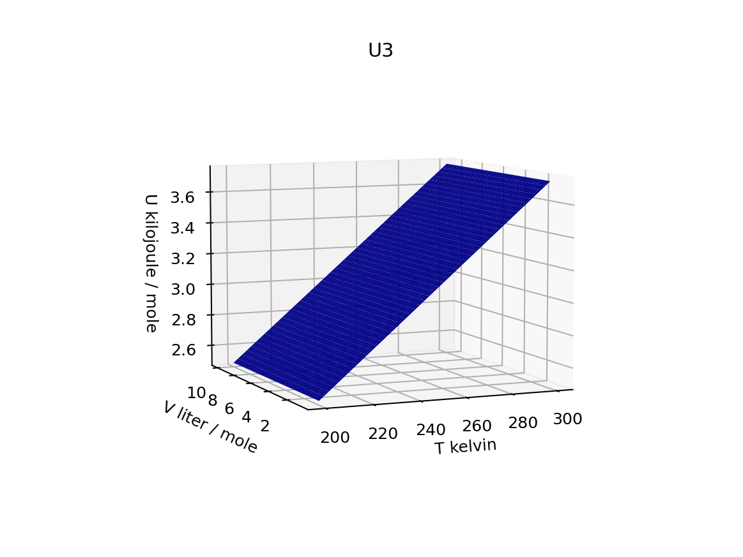
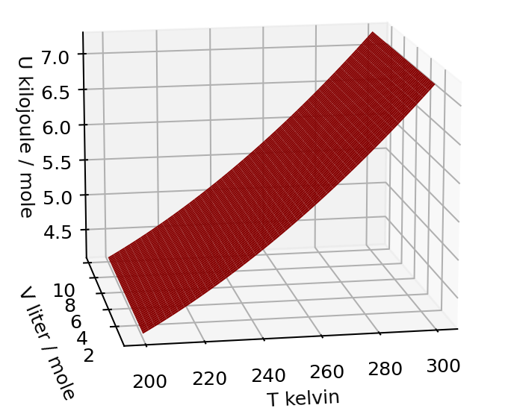
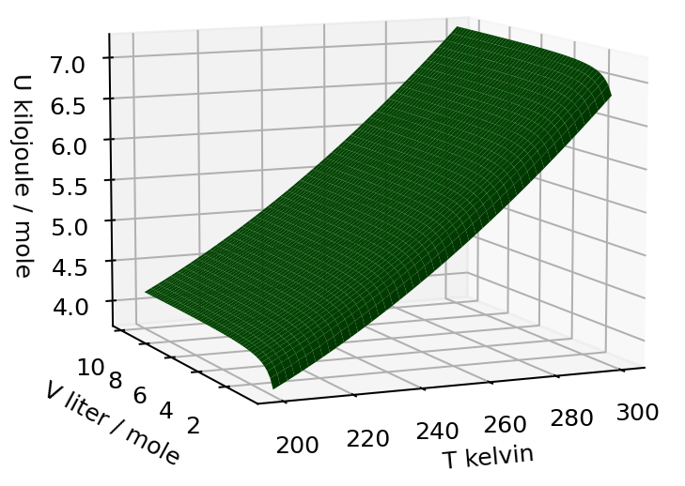
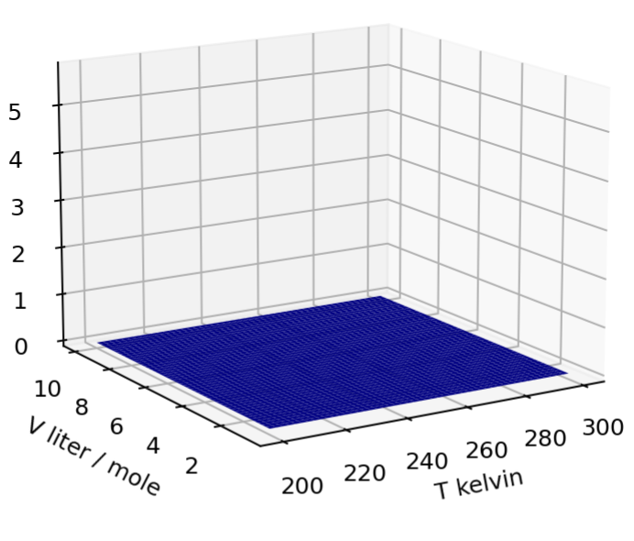
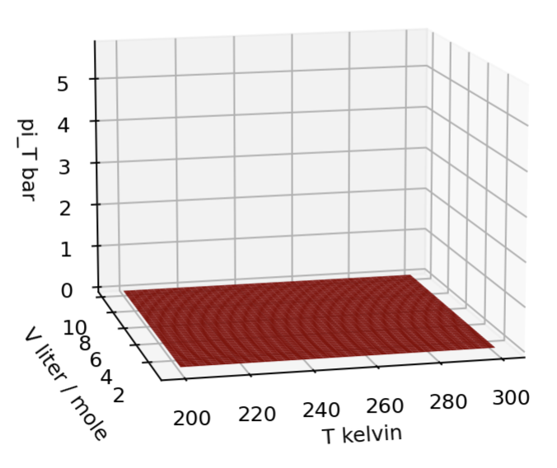
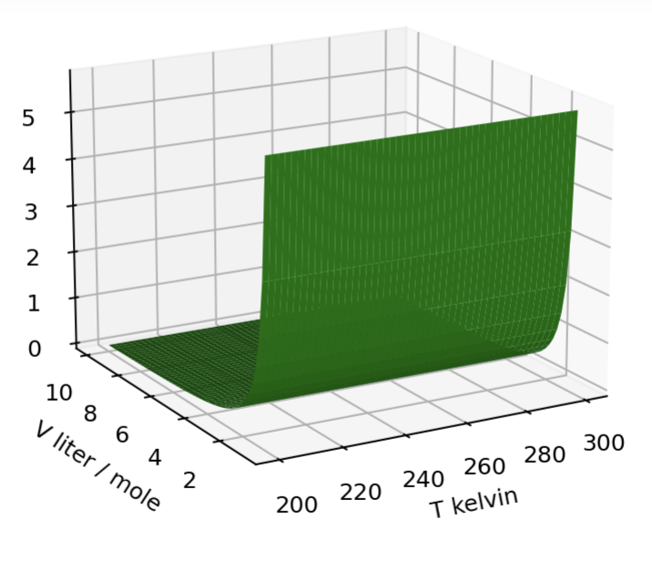


Visualizing $U(T,V)$ and ${π_{T}≡\left(\frac{∂U}{∂V}\right)}_{T}$as a thermodynamic surfaces
$$U(T,V)$$
$$π_{T}(T,V)$$
Flat in the volume direction
Highly sloped in the volume direction (at low V)

